Slide 1
Github, R Tricks, Visual Studio Coding
Aight y’all, time to UP YOUR GAME

Slide 2
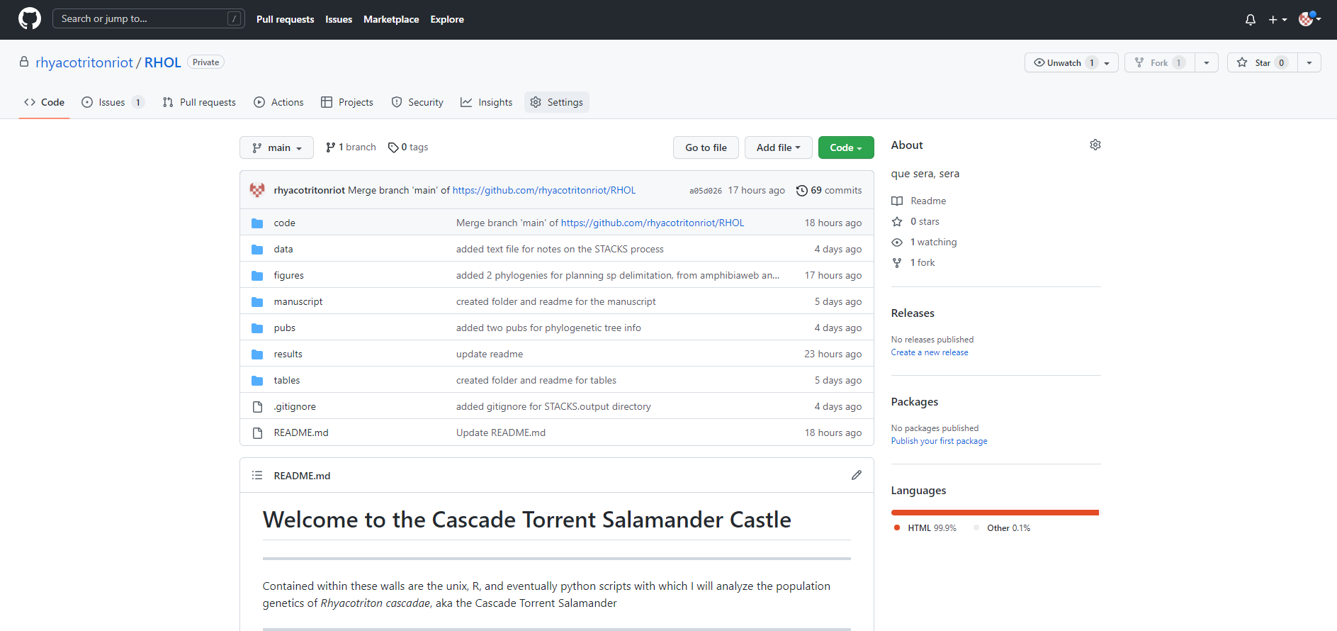
Github

Slide 3
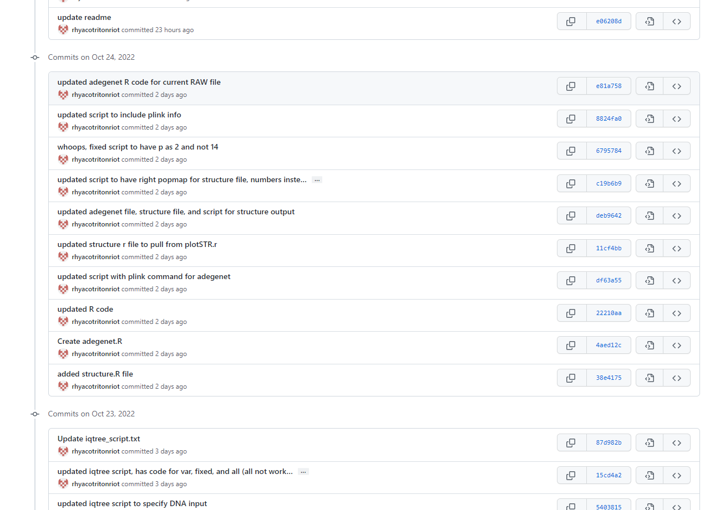
Github – Version Control

Slide 4
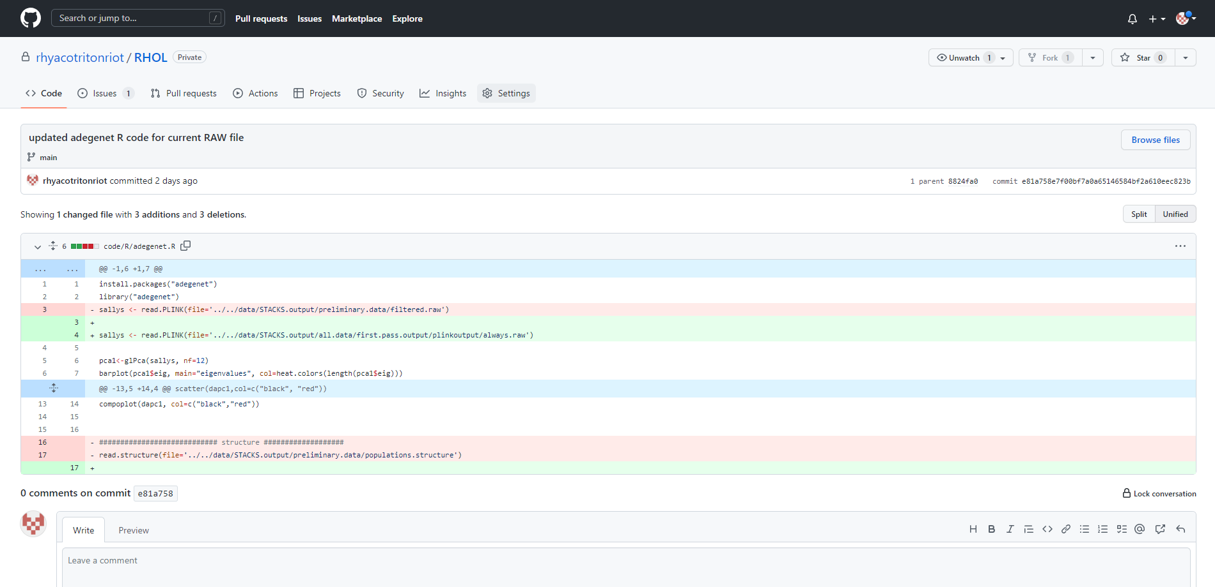
Github – Version Control

Slide 5
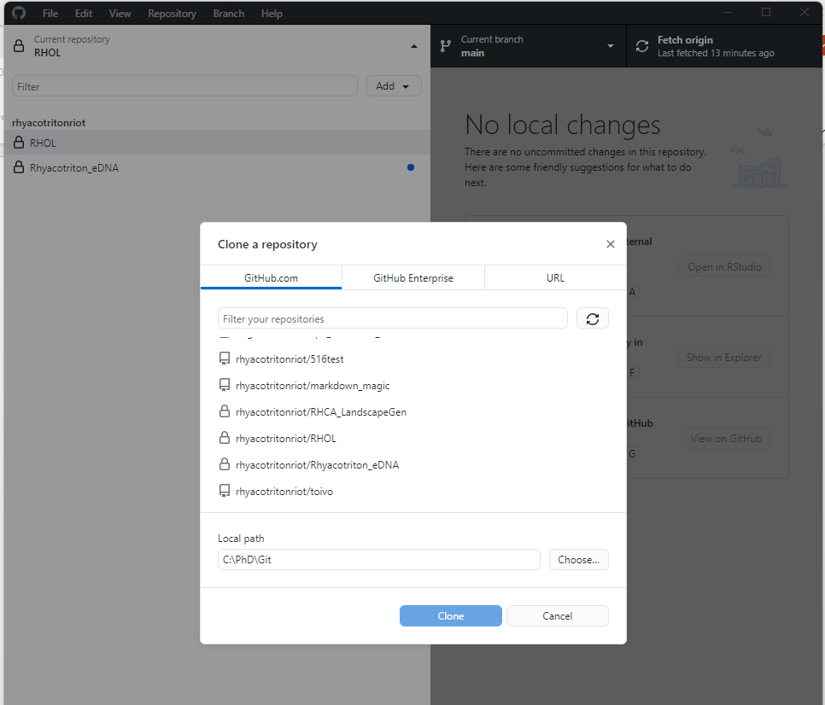
Github – Cloning Repositories

Slide 6
Github – Cloning Repositories

Slide 7
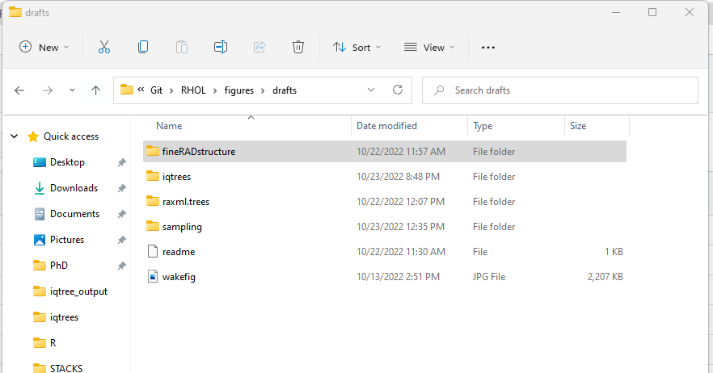
Github – Cloning Repositories

Slide 8
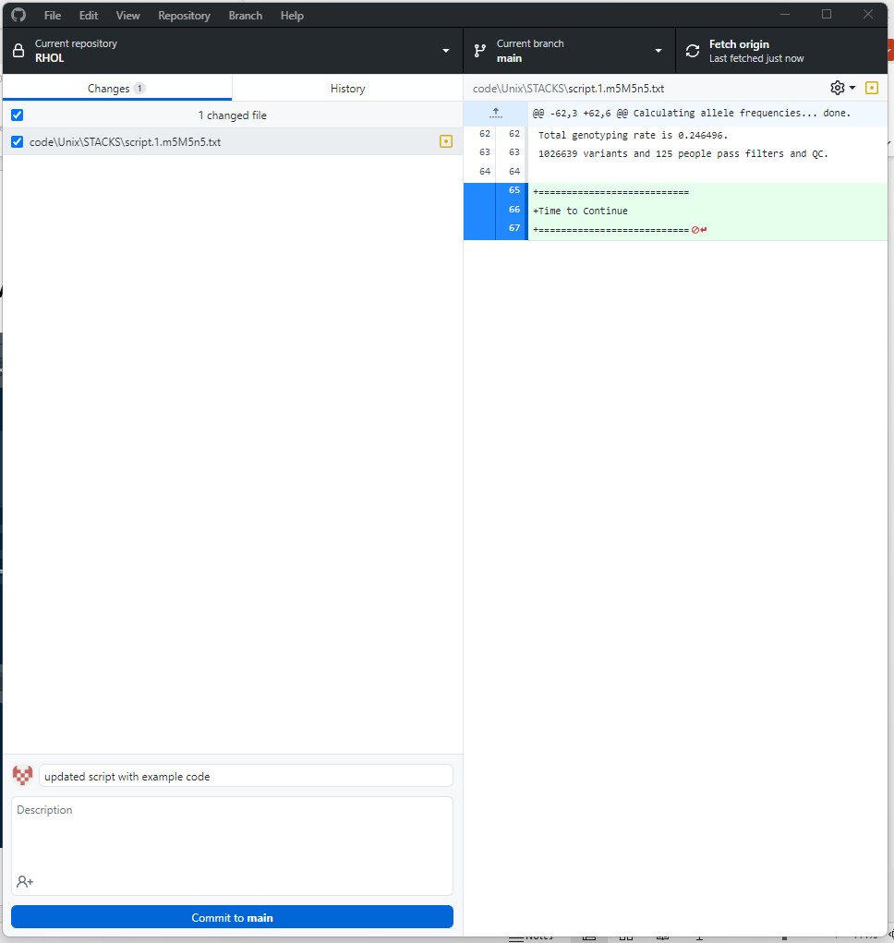
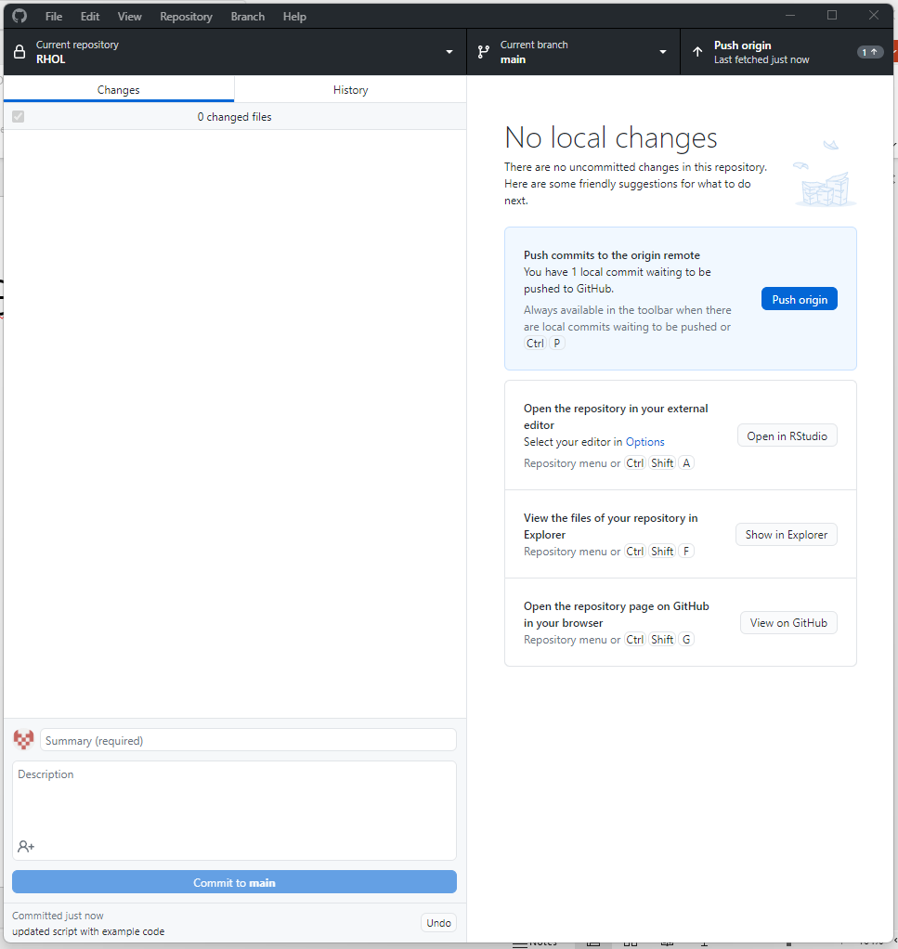
Github Connectivity – Github Desktop

Slide 9
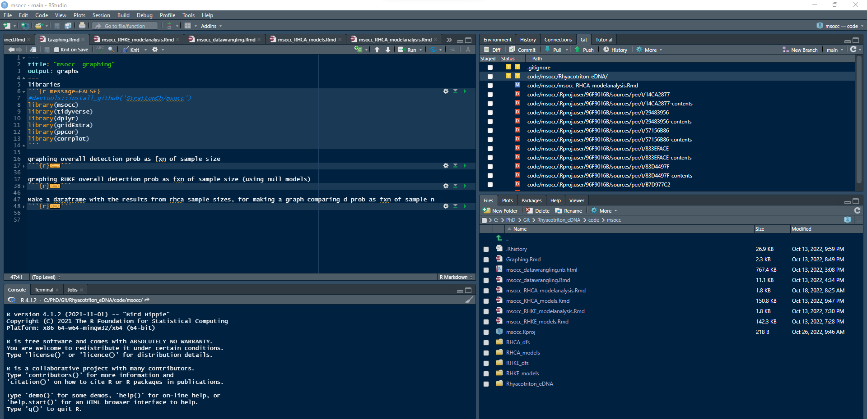
Github Connectivity – R Studio

Slide 10
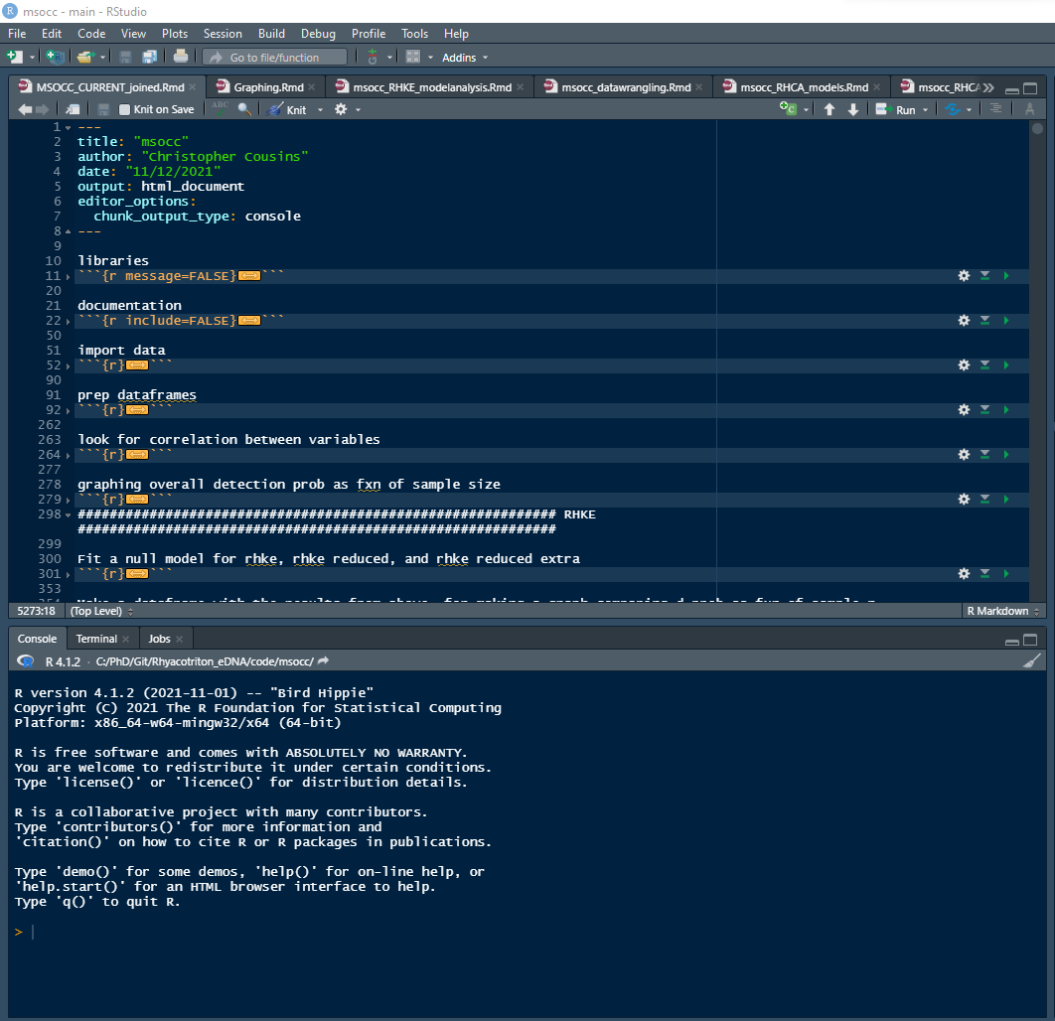
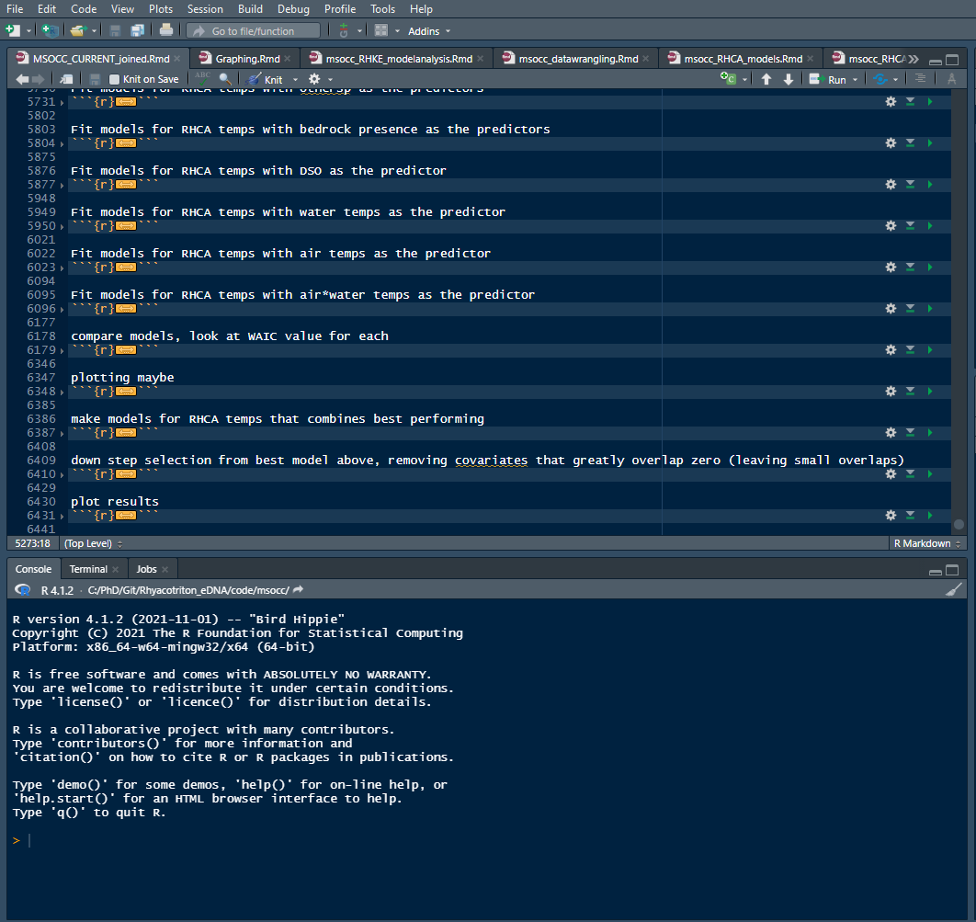
Github and R – Pre-modularization

Slide 11
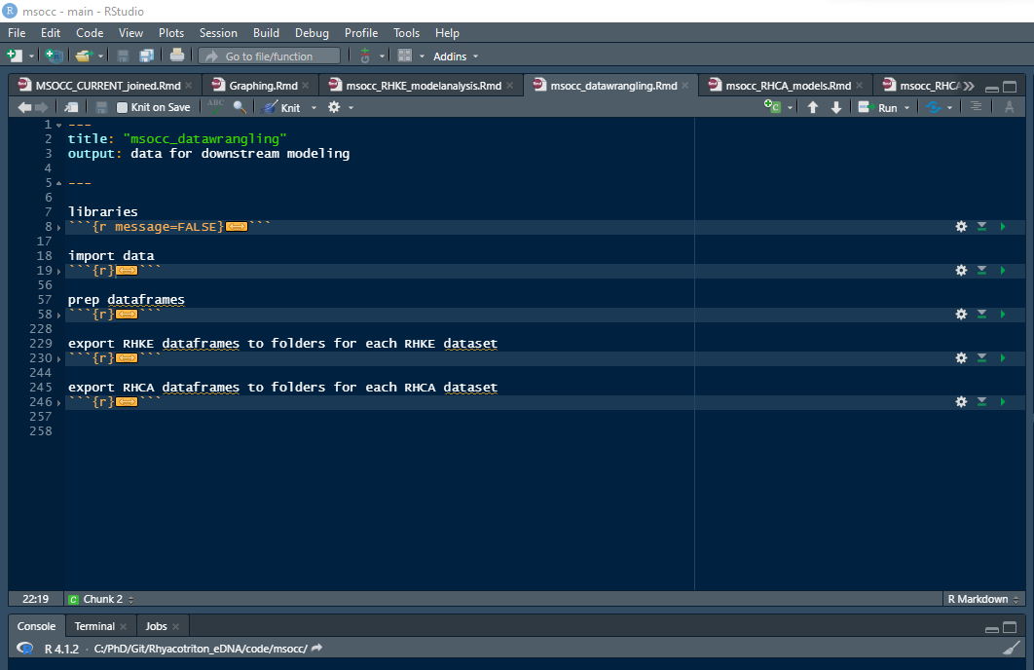
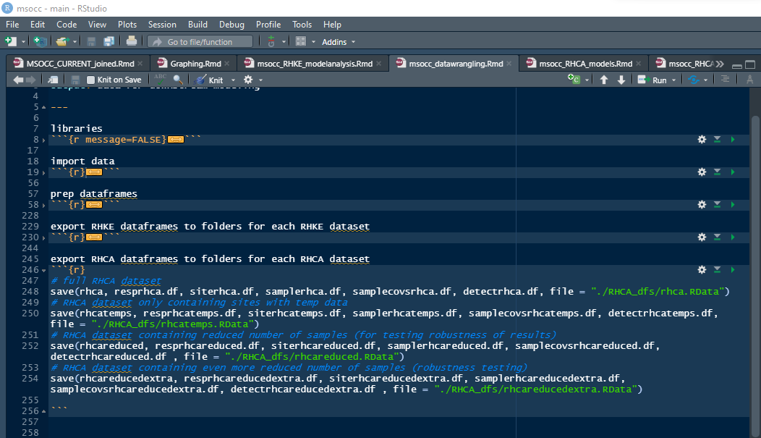
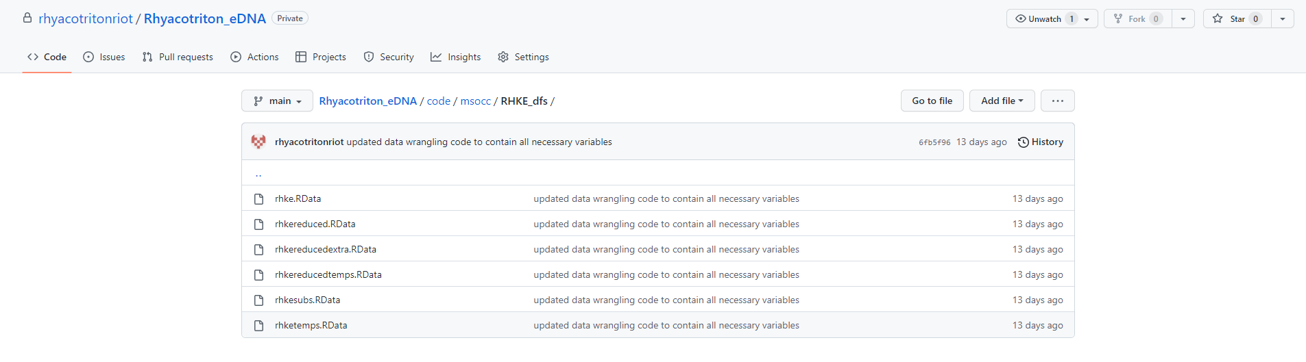
Github and R – Post-modularization

Slide 12
Github and R – Post-modularization

Slide 13
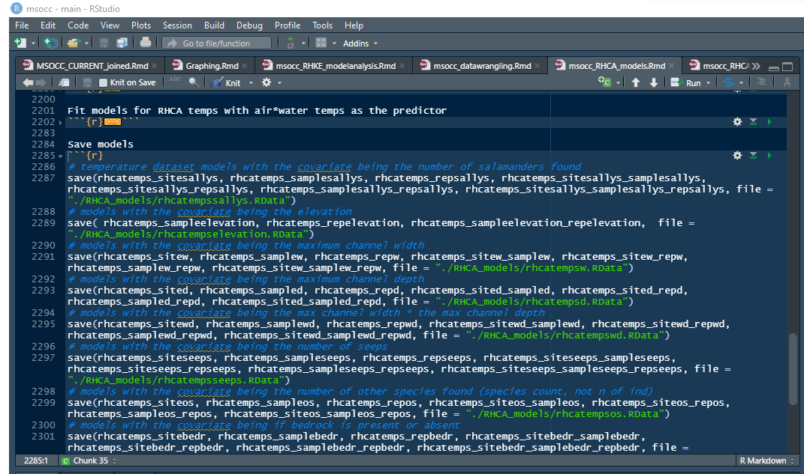
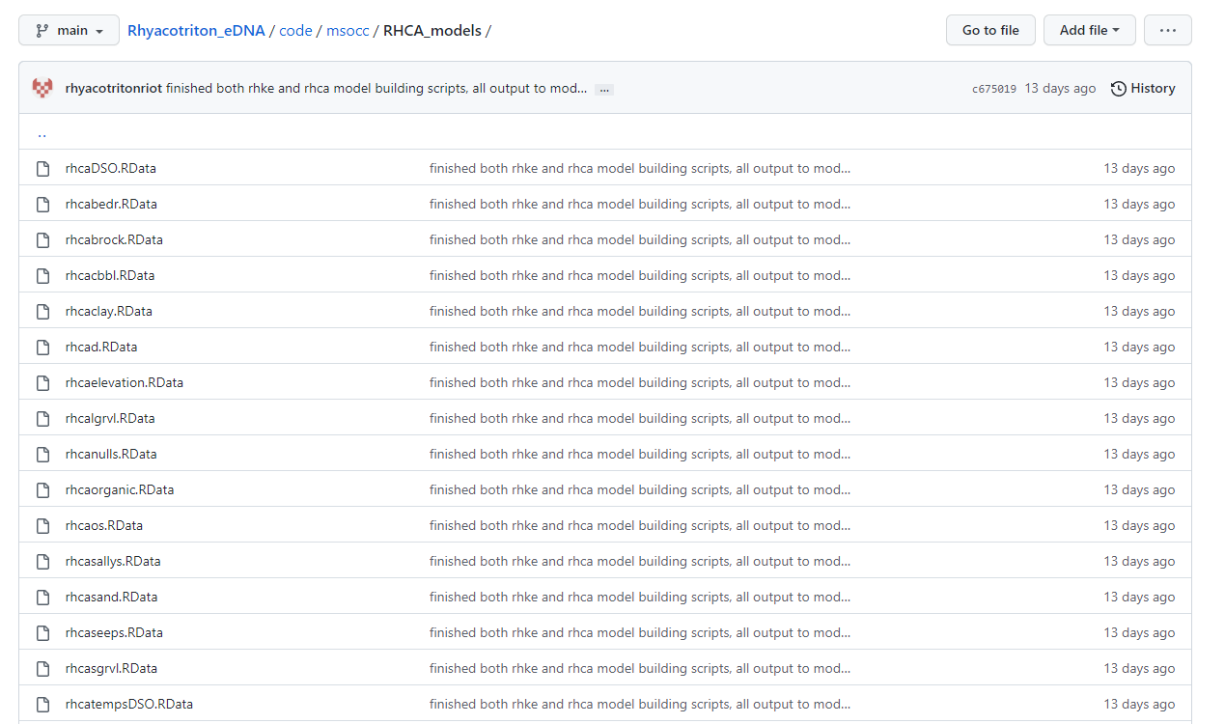
Github and R – Post-modularization

Slide 14
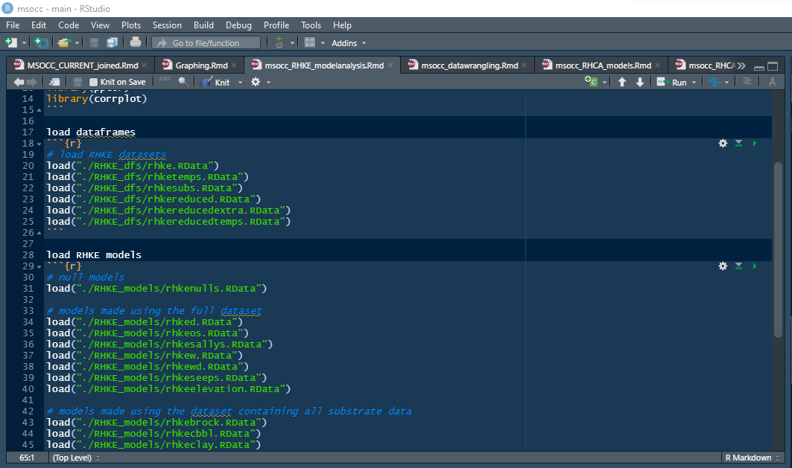
Github and R – Post-modularization

Slide 15
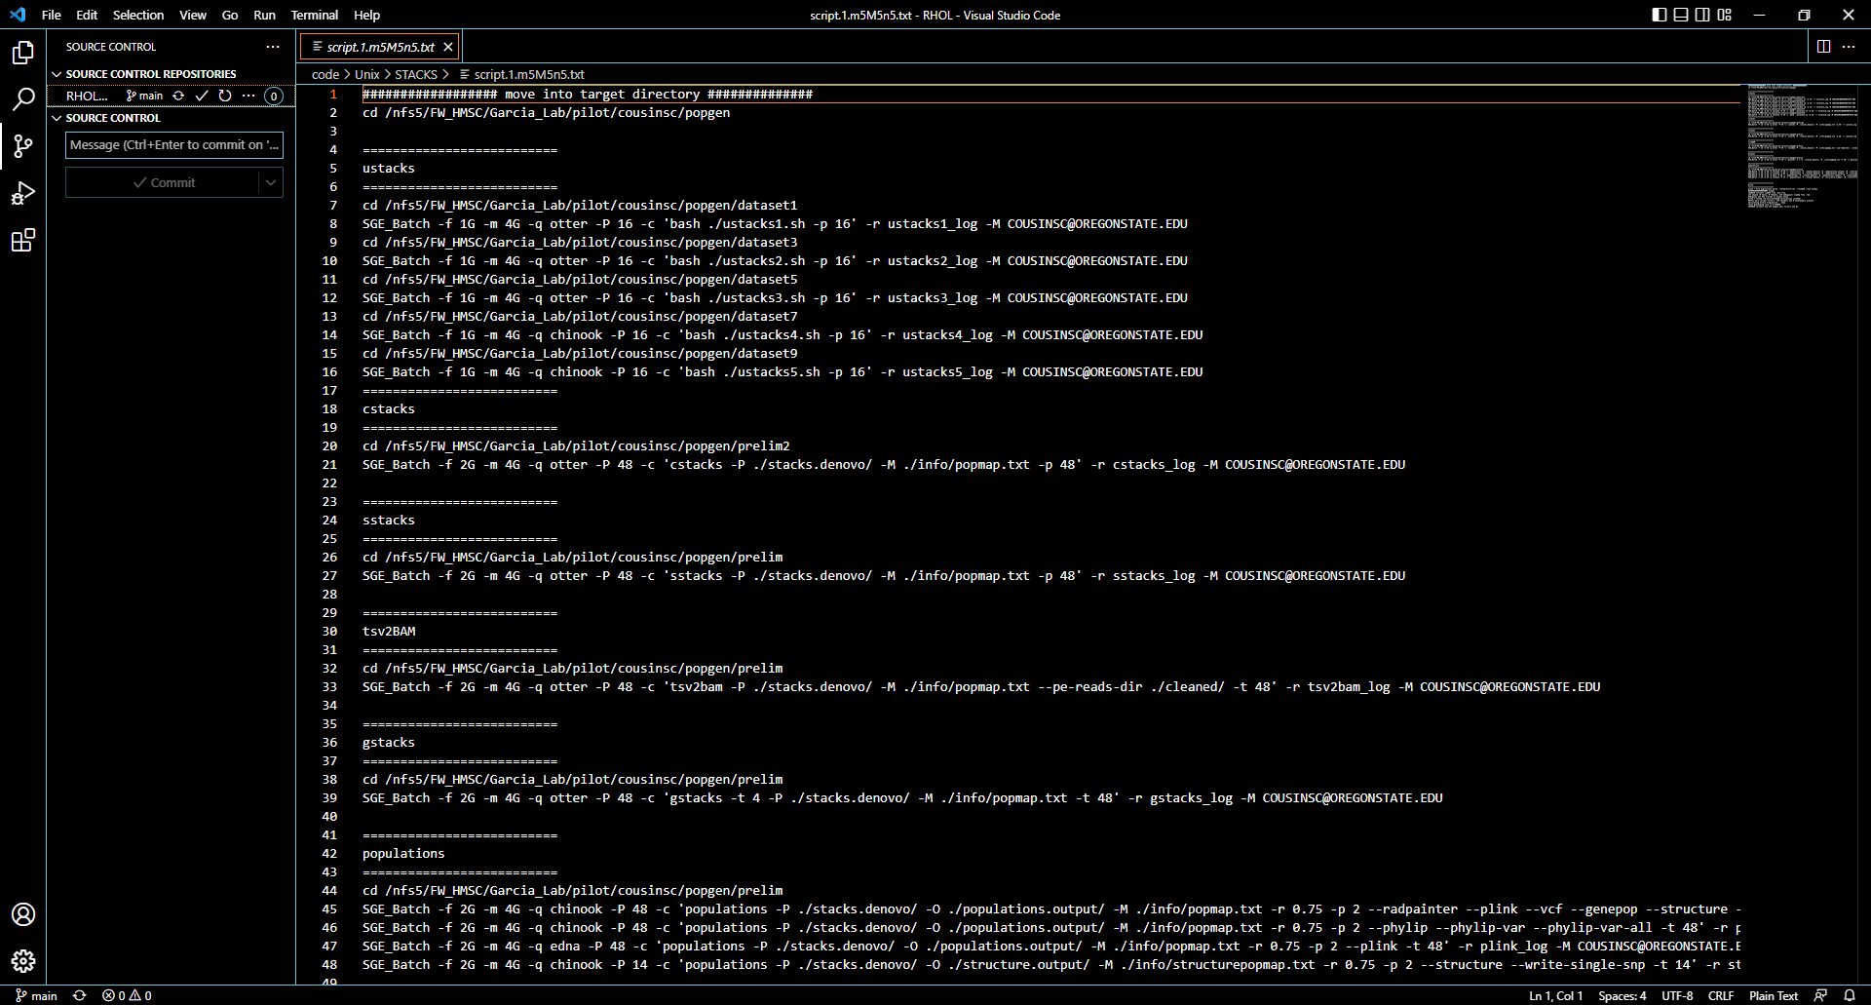
Github Connectivity – Visual Studio Code

Slide 16
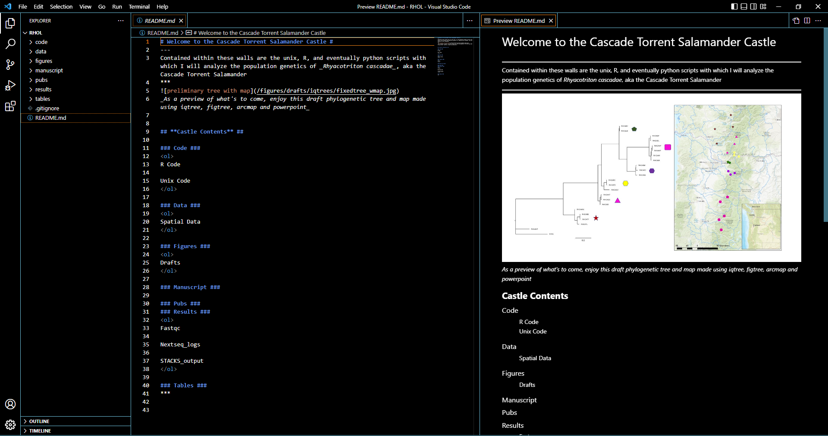
Github Connectivity – Visual Studio Code

